Slide 1
Air Monitoring
Group:
Aufa Dhyia Aydan 1706043260
Muhamad Fadil 1706042812
Muhamad Farhan 1706042876

Slide 2
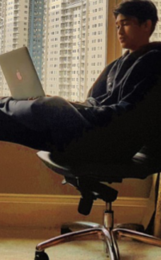


Place your screenshot here
Muhammad Farhan
Muhamad Fadil
Aufa Dhiya Aydan
https://thingsboard.io/

Slide 3
Outline
Introduction
Project management
Design and analyses
Implementation

Slide 4
Introduction

Slide 5
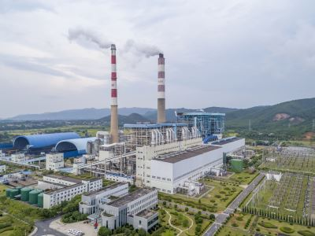
Air Monitoring
Air Quality is a tool used to determine the condition of the air around our environment. The device detects the level of CO2 around it so that the levels are monitored and displayed on the thinger.io or web page.

Slide 6
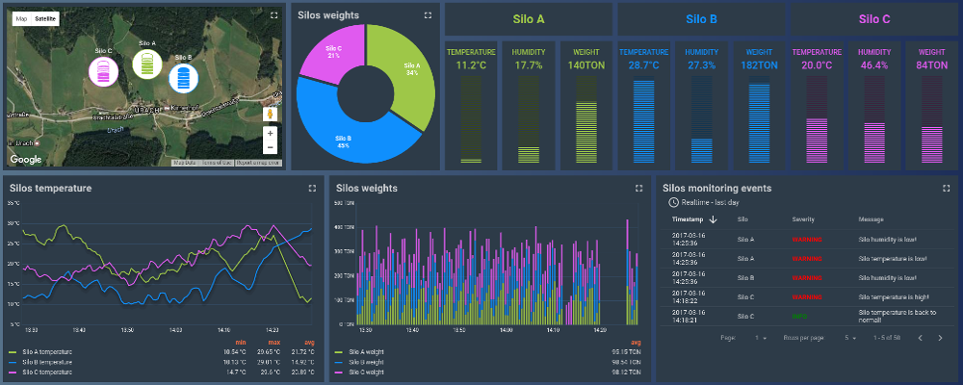
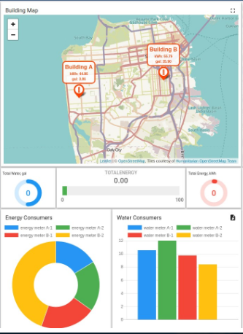
Air Monitoring
Place your screenshot here
https://thingsboard.io/

Slide 7
Idea From
Friend and Internet

Slide 8
Project Managment

Slide 9
Features
a. Web thingsboard
b. Humidity and Temperature Sensor
c. Mobile apps
d. Data from device is stored at thinger.io
e. Realtime data
f. http access
3. Tools:
a. MQ135 sensor
b. ESP 32
c. Thingsboard
d. Breadboard

Slide 10
PLAN PROJECT
Project Plan is a project plan that uses
Programming Languages: Arduino, JSON
Repository: github
Framework: -
IDE : Arduino IDE, Notepad++
Cloud: We use a database from Thingsboard that already provides an API

Slide 11
Requirement Analysis
The Air Quality Application Program that we created is designed to determine the humidity and temperature around the FT environment. Users only need to open the platform that we provide, then there will be a display of information about Humidity levels in every place that we install the air quality tool, in that platform we will also display information on whether the Humidity level has reached a good or bad stage in the environment.
• User page
A1. The user only sees the available page interface
• Admin page
B1. Admin can update Humidity levels
B2. Admin can update whether the Humidity condition is good enough or bad enough

Slide 12
Code & Support
Code : This Air Quality application project was designed using the Web (php, css, html), App (the application's own language), and Thingsboard (Arduino).
Support : All pc specifications are all biased

Slide 13
WHY ???
So that users can see the current conditions of temperature and humidity around the device that we make

Slide 14
Benefit
Can tell the temperature and humidity conditions

Slide 15
Views

Slide 16
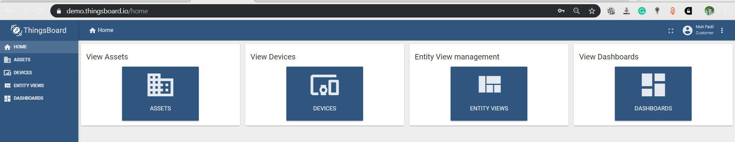

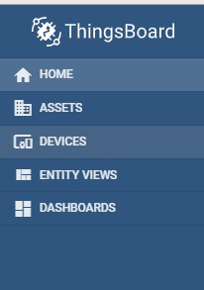
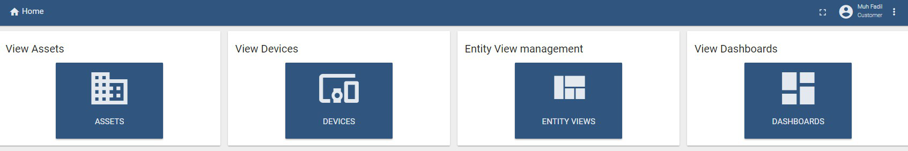
For User

Slide 17
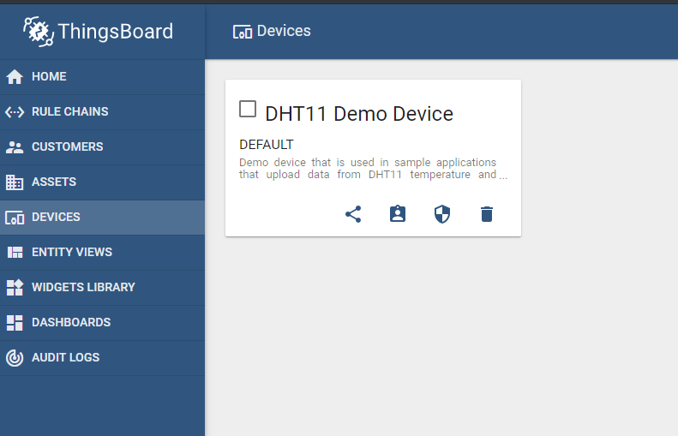
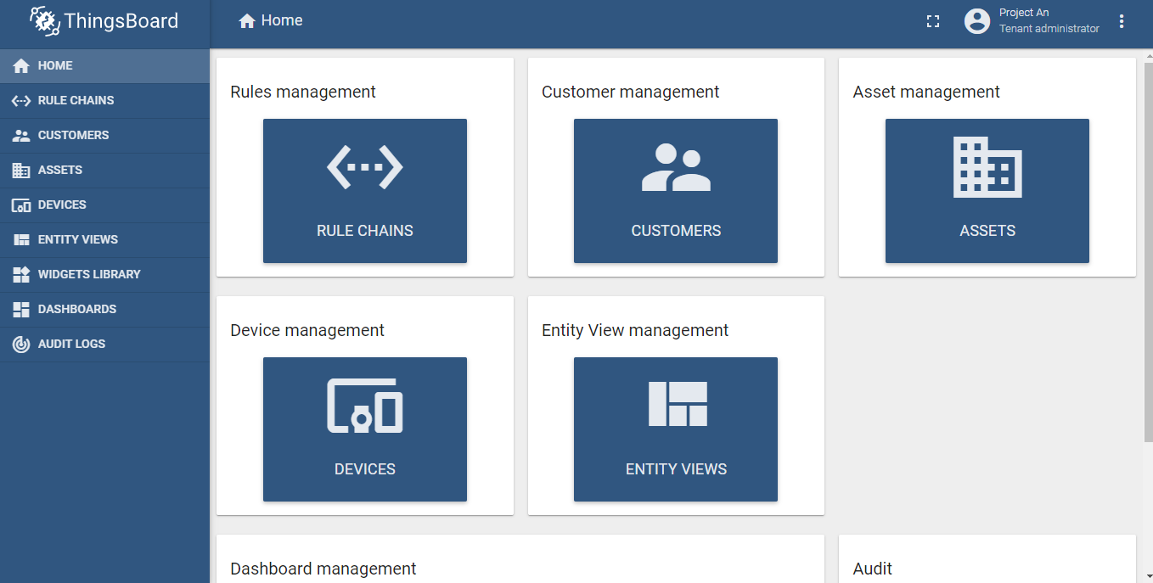

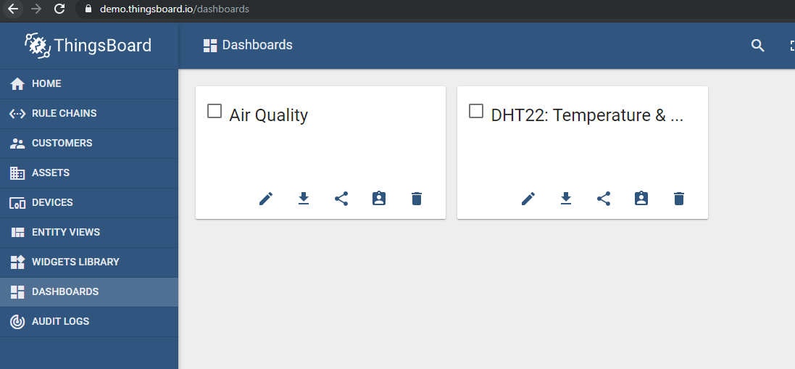
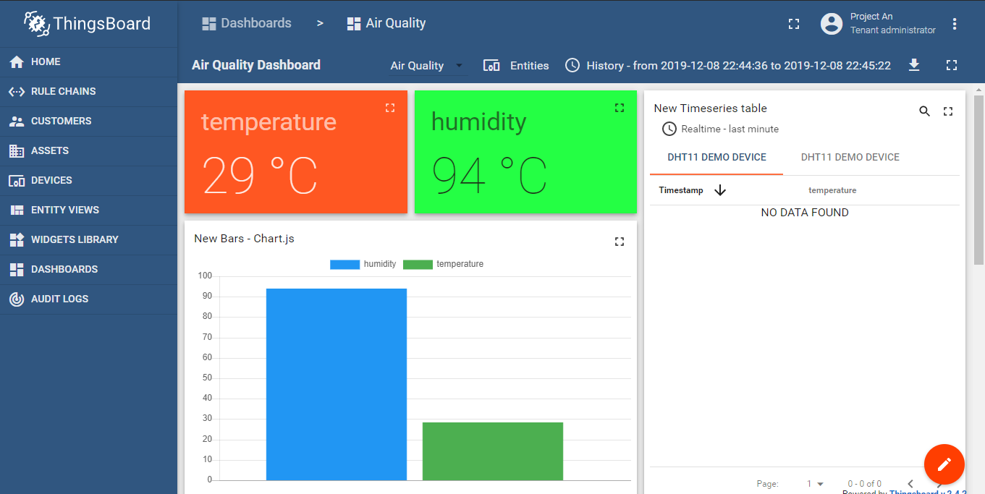
For Admin

Slide 18
Test Case

